Slide 1



RNN, LSTM, GRU
Ahmad Fathan Hidayatullah, S.T., M.Cs.

Slide 2
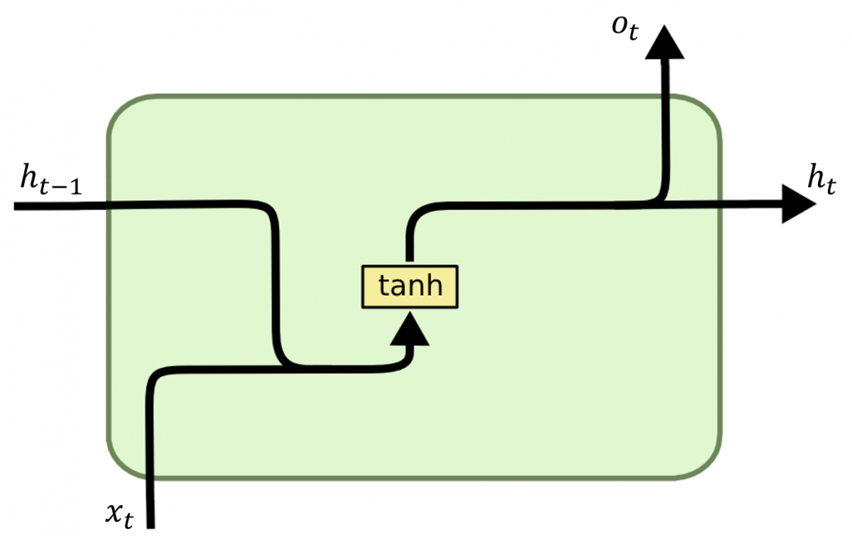
RNN (Recurrent Neural Network)

Slide 3
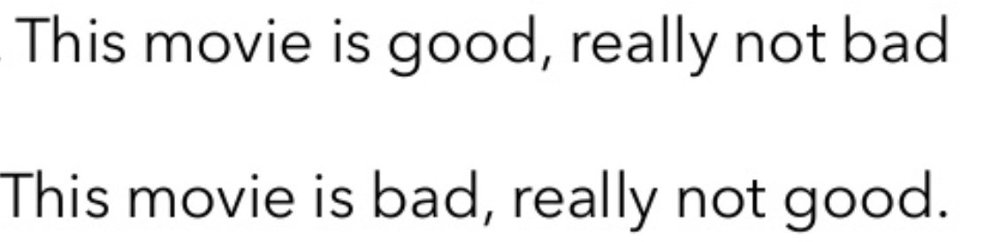
Motivation of RNN
Sequential data, time step input (order data matters).
Sharing parameter across different part of model.
Separate parameter cannot generalize in different time steps.
E.g. “I went to Madina in 2019” vs “In 2019, I went to Madina”
2019 is the key info we want, regardless it appears in any position
vs

Slide 4
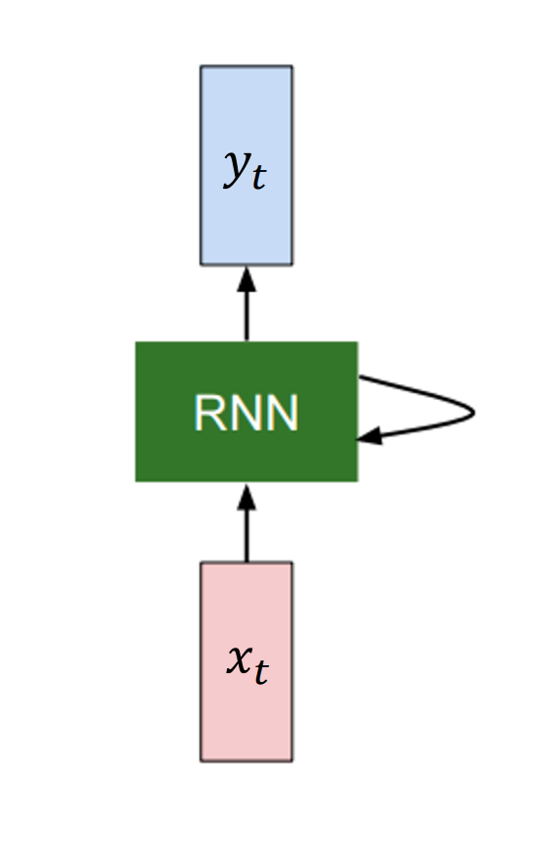
RNN
Takes a new input.
Manipulate the state.
Reuse weights.
Gives a new output.

Slide 5
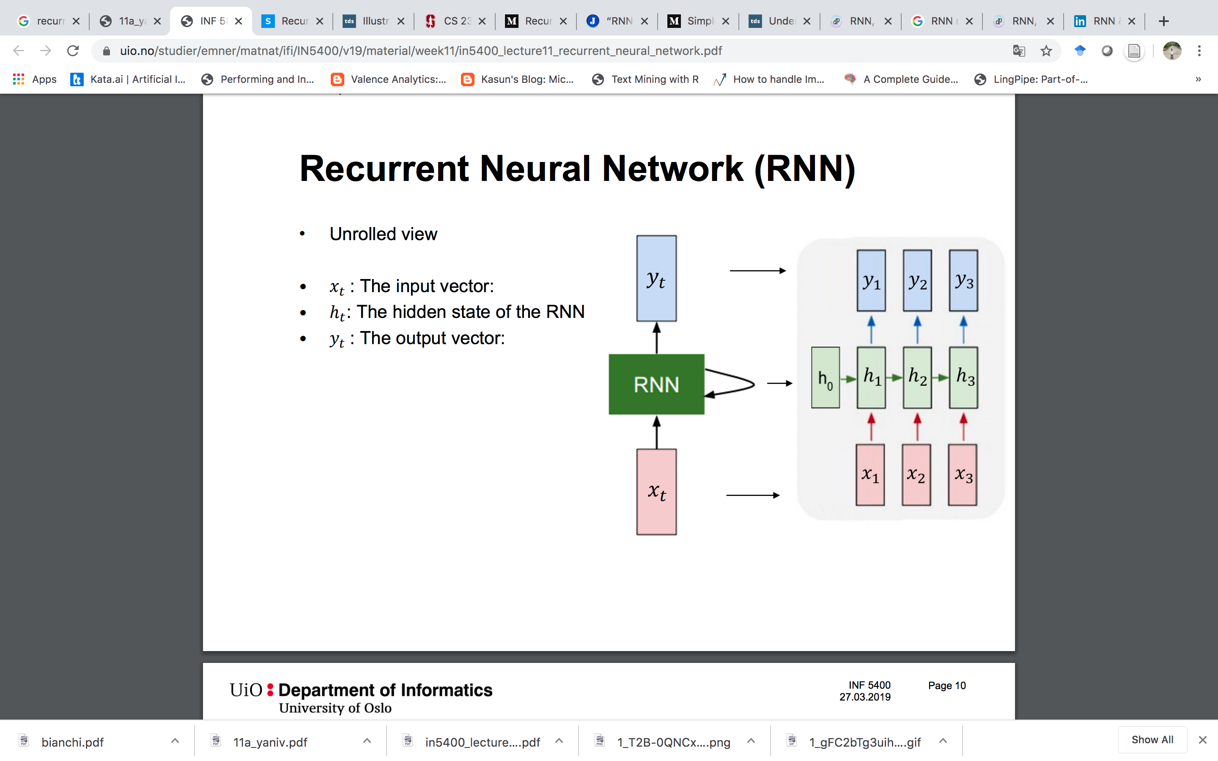
RNN (Unrolled View)

Slide 6
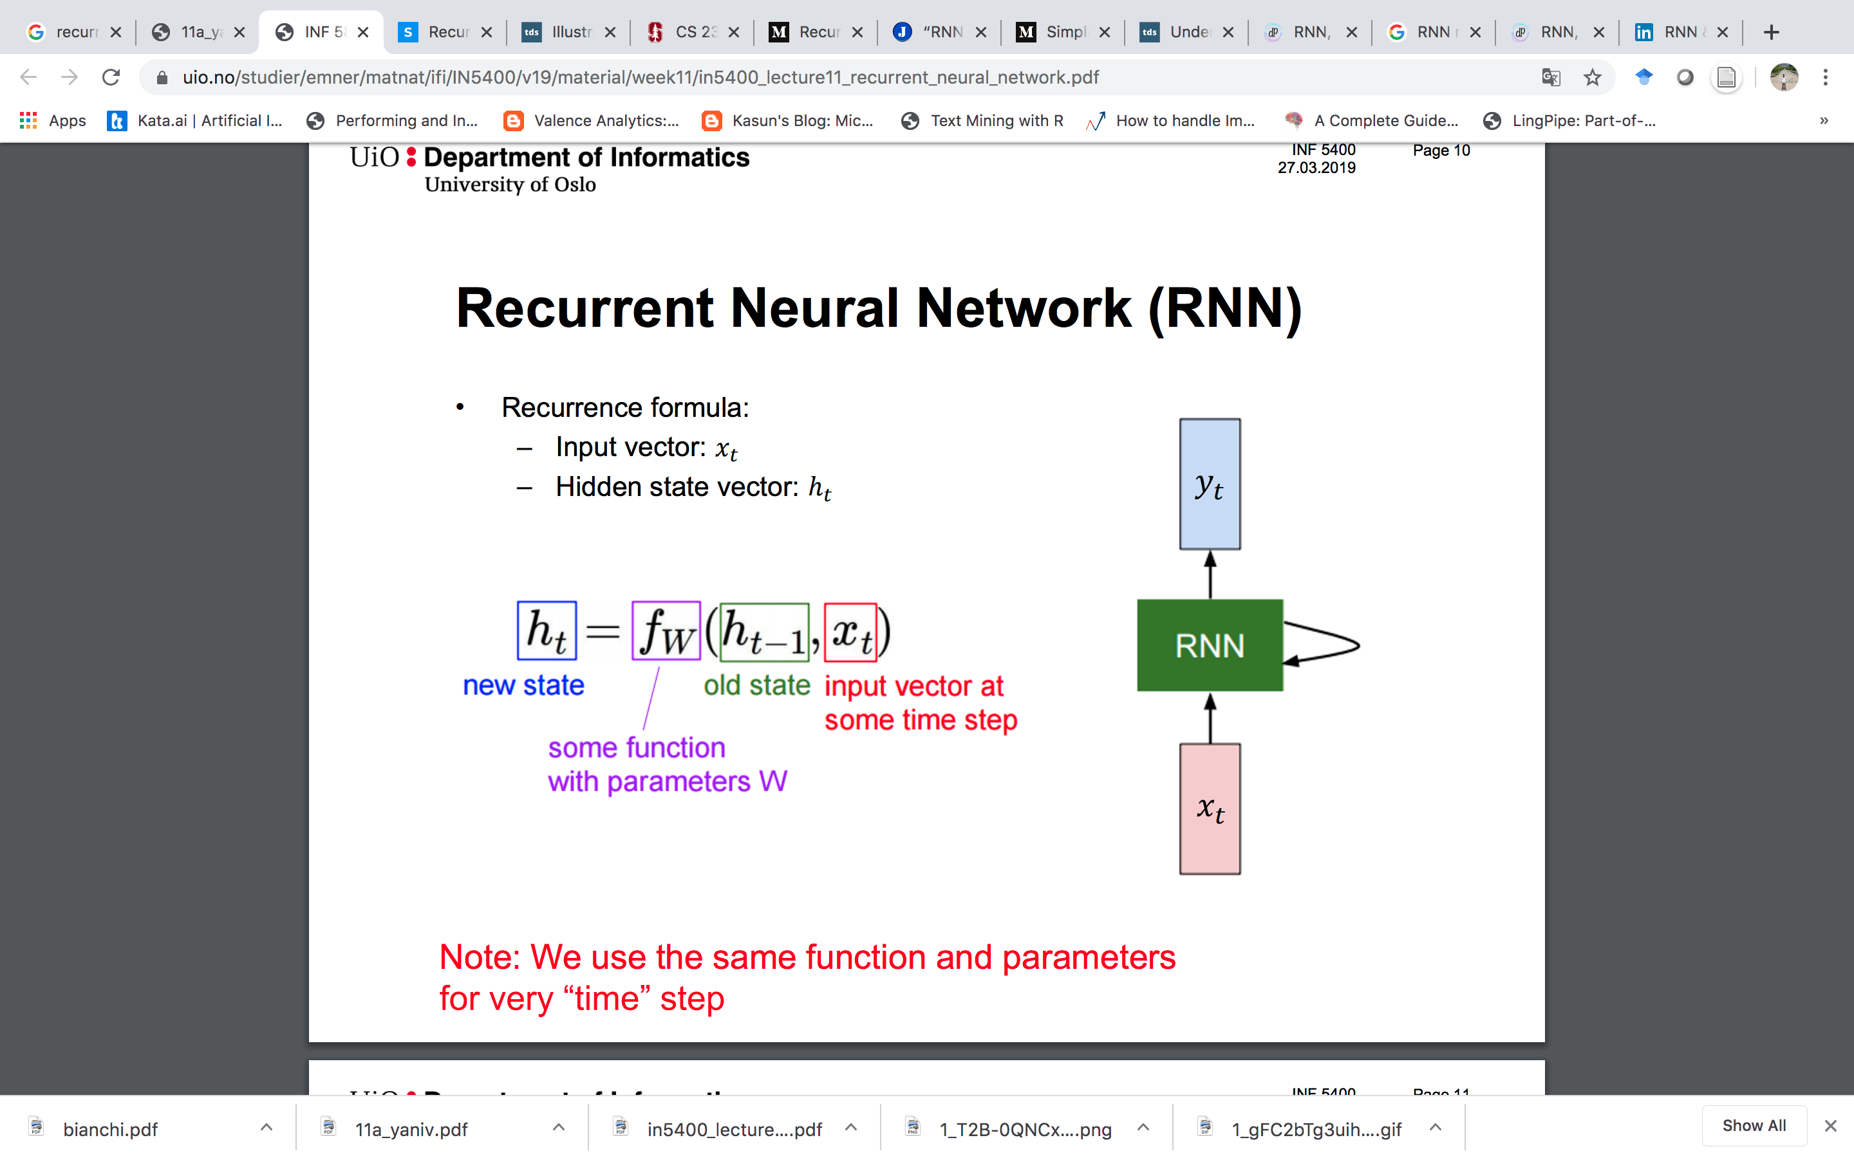
RNN

Slide 7
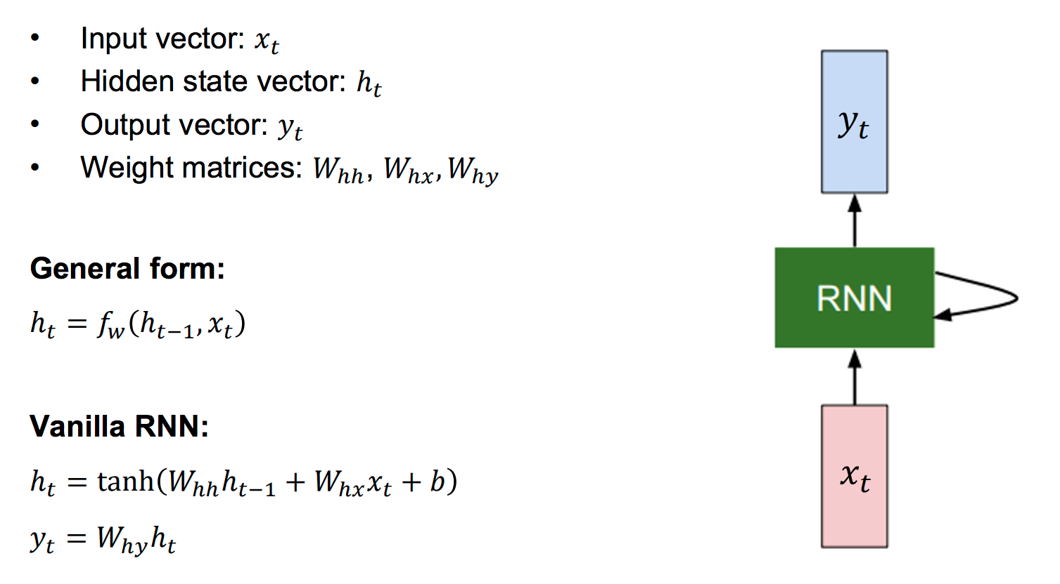
RNN Equations

Slide 8
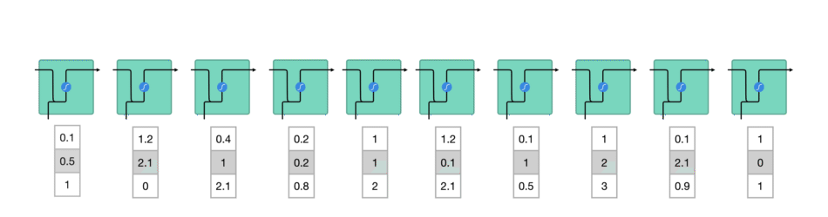
How RNN works?
Transform words into machine-readable vectors.
RNN will process the sequence of vectors one by one.

Slide 9
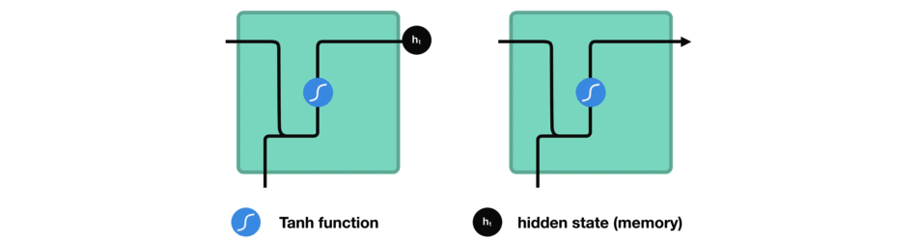
How RNN works?
While processing, it passes the previous hidden state to the next step of the sequence.
The hidden state acts as the neural networks memory.
It holds information on previous data the network has seen before.

Slide 10
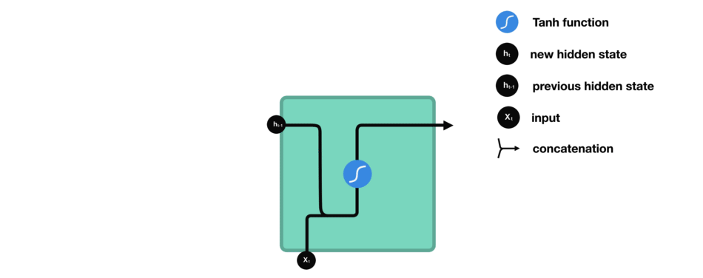
How RNN works?
How RNN calculates the hidden state?
The input and previous hidden state are combined to form a vector. That vector now has information on the current input and previous inputs.
The vector goes through the tanh activation, and the output is the new hidden state, or the memory of the network.

Slide 11
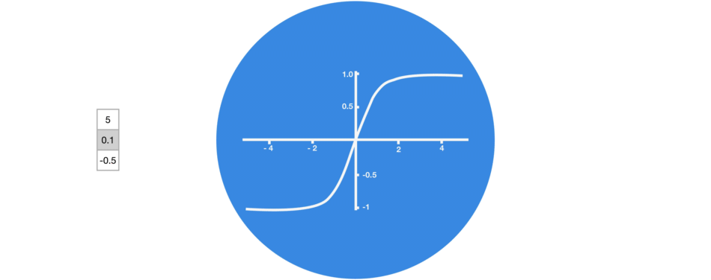
Why tanh?
The tanh activation is used to help regulate the values flowing through the network.
The tanh function squishes values to always be between -1 and 1.

Slide 12
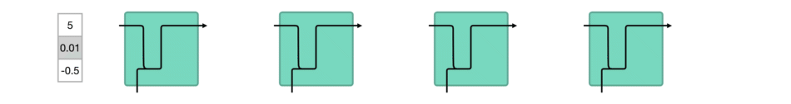
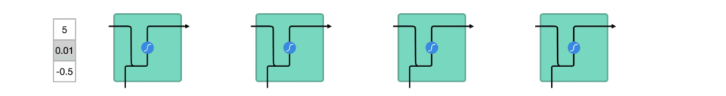
Vector Transformations with vs without tanh
So imagine a value that continues to be multiplied by let’s say 3.
We can see how some values can explode and become astronomical, causing other values to seem insignificant.
Without tanh
With tanh

Slide 13
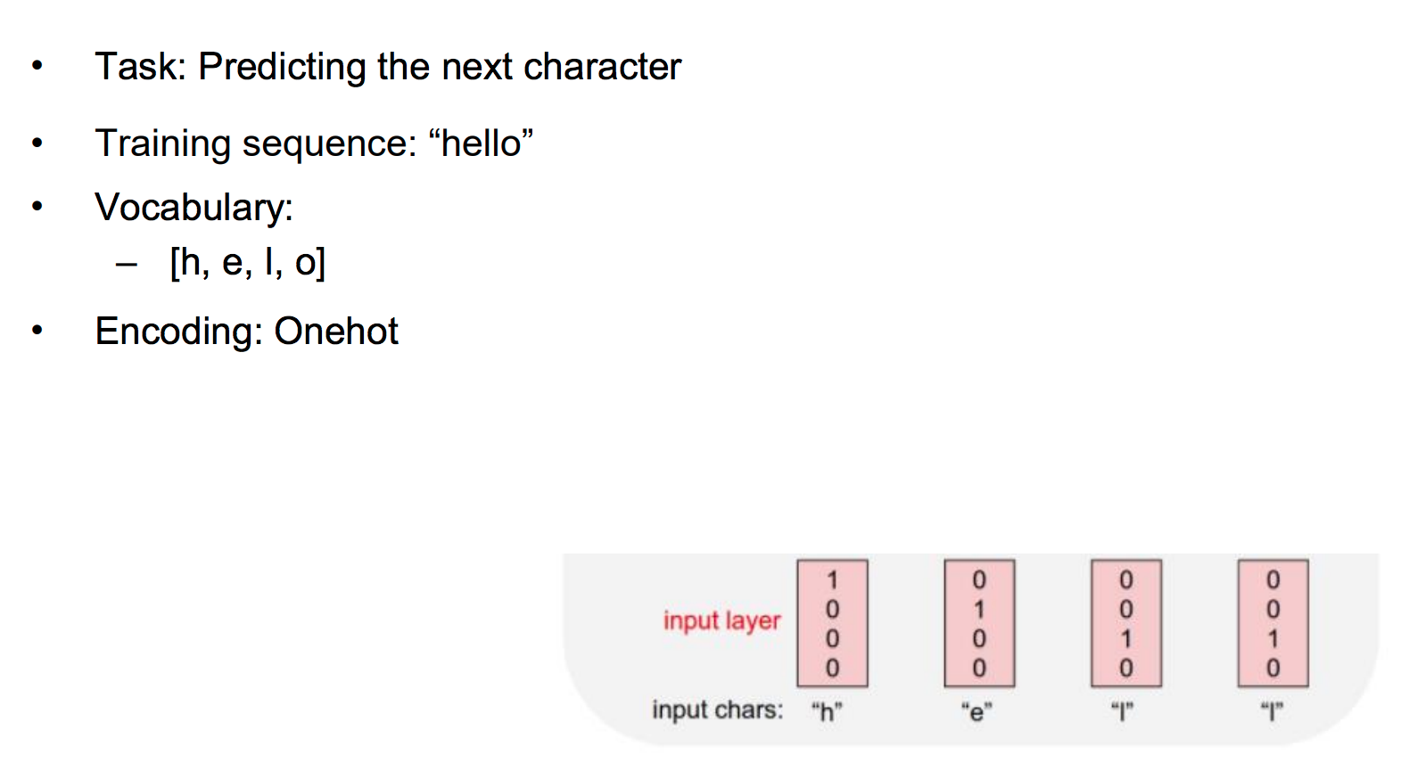
Example: Language Model

Slide 14
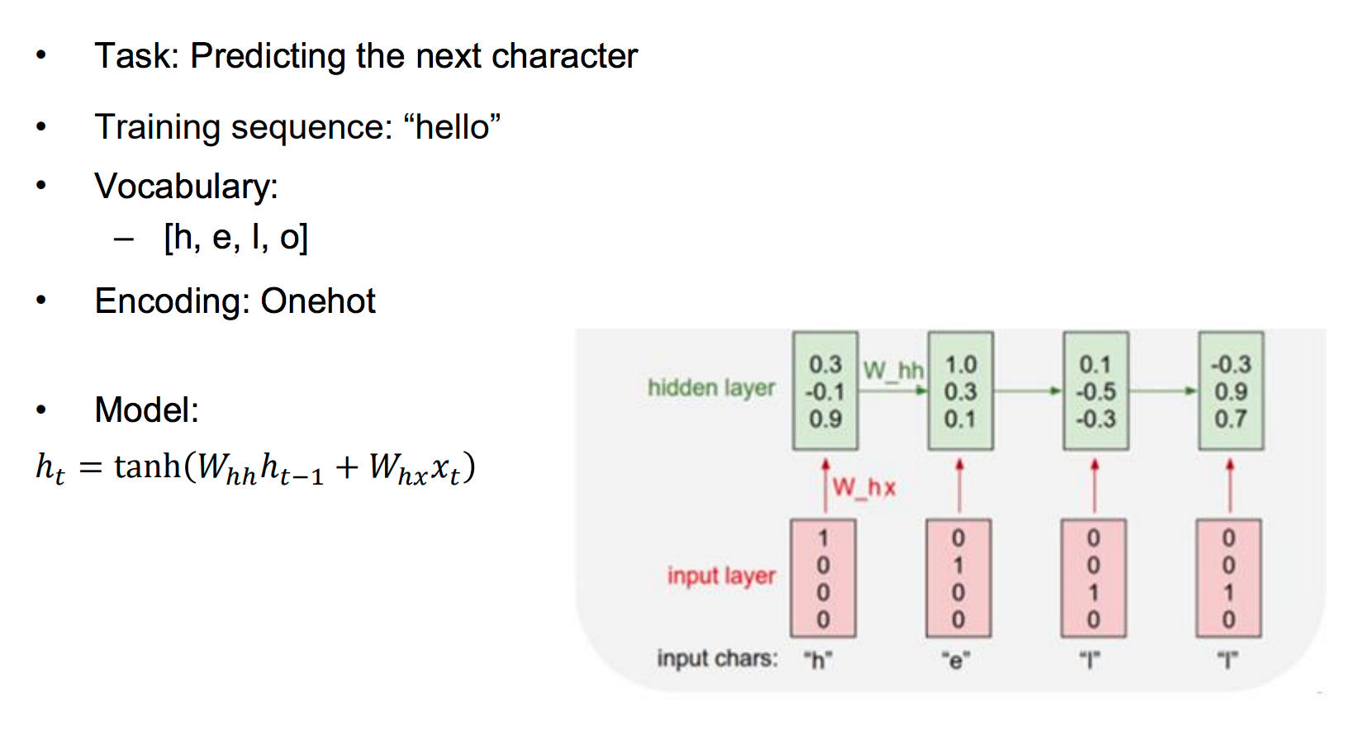
RNN: Predicting The Next Character

Slide 15
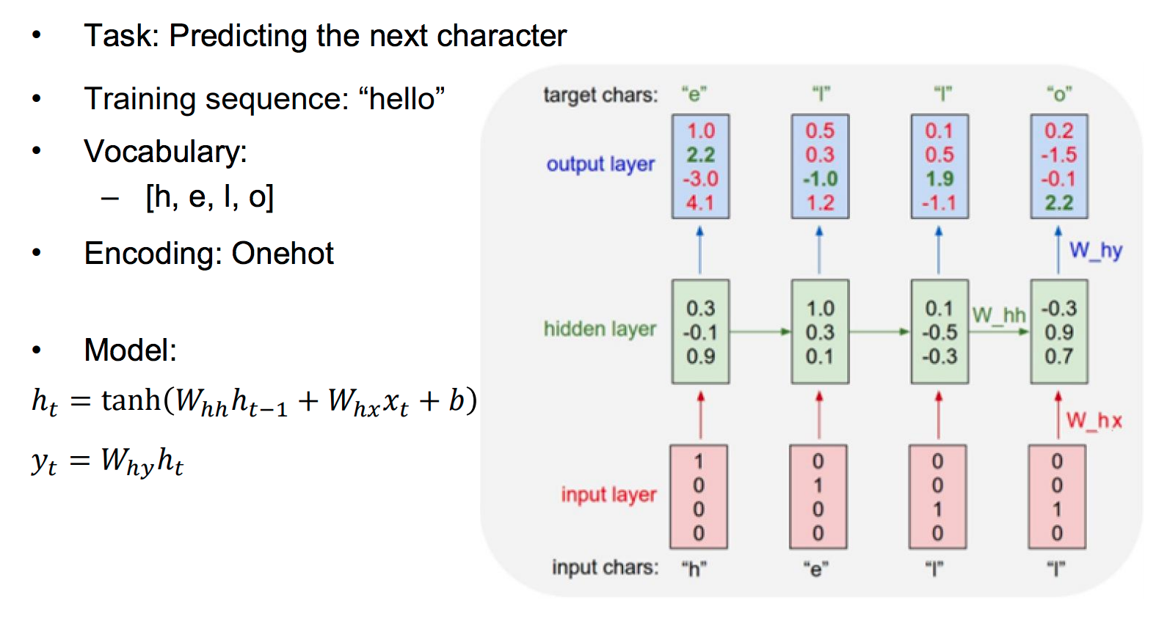
RNN: Predicting The Next Character

Slide 16
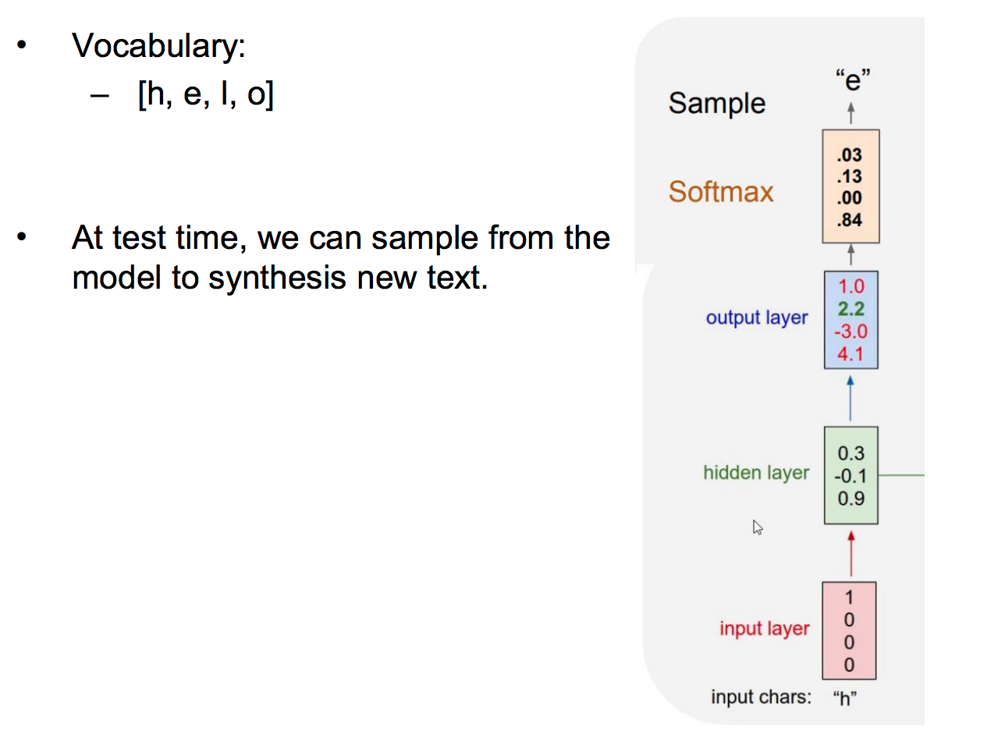
RNN: Predicting The Next Character

Slide 17
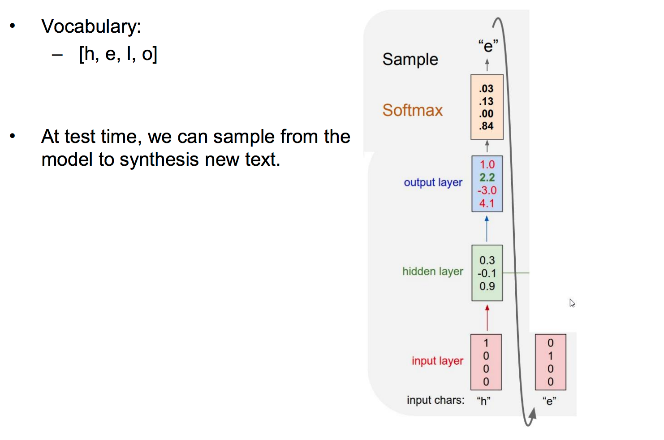
RNN: Predicting The Next Character

Slide 18
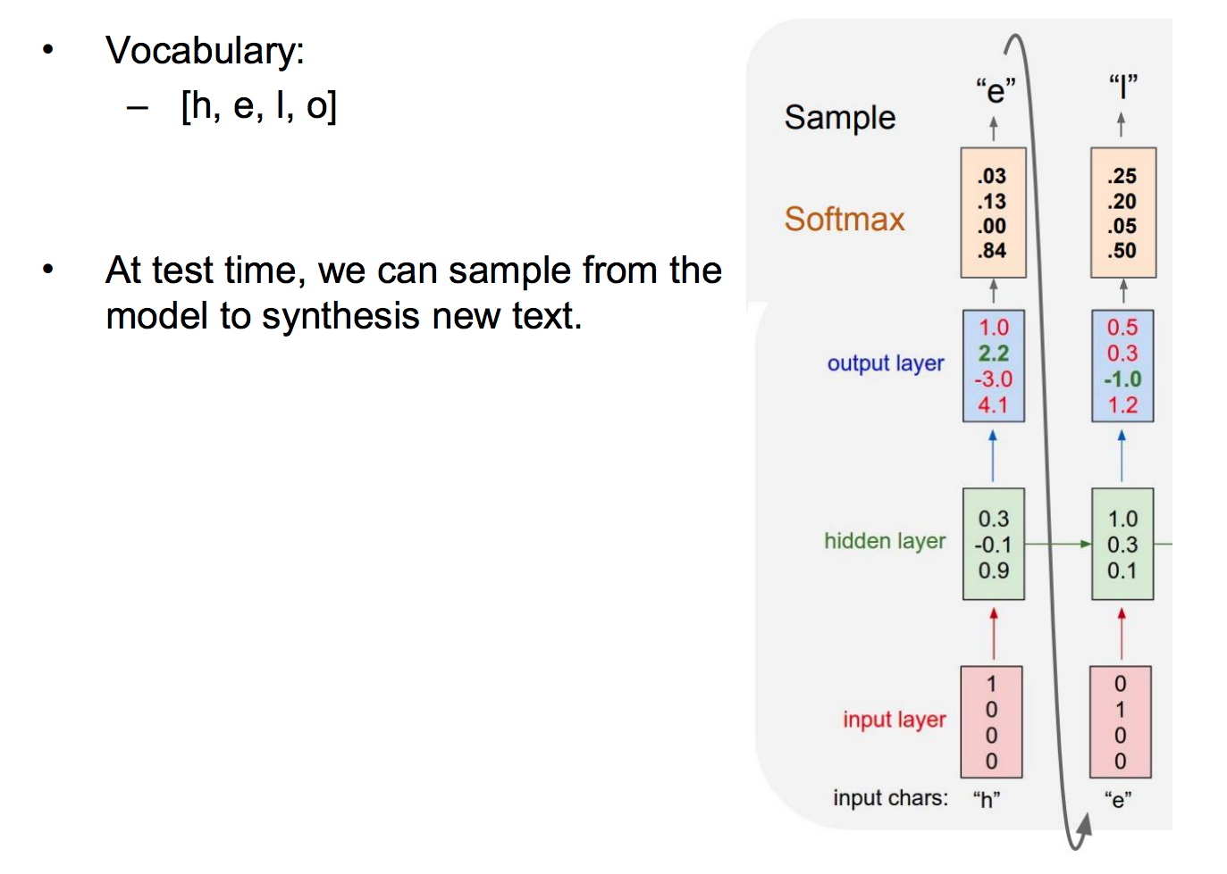
RNN: Predicting The Next Character

Slide 19
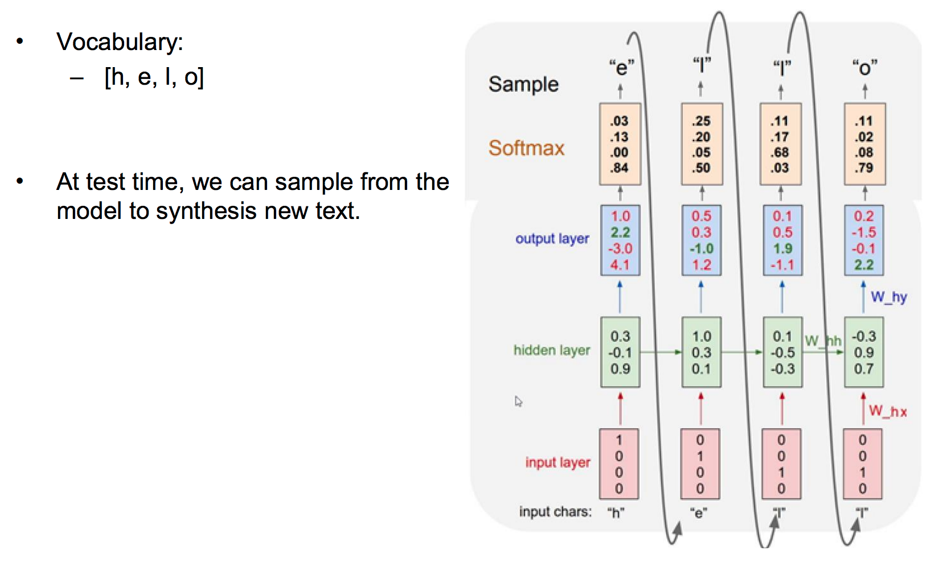
RNN: Predicting The Next Character

Slide 20
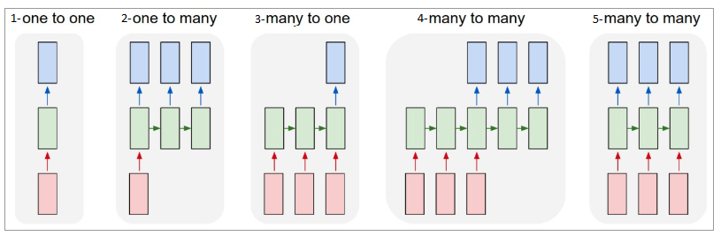
Different Types of RNN Architecture

Slide 21
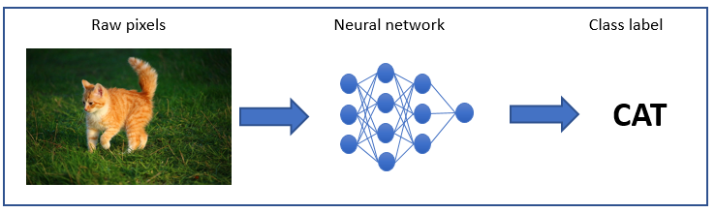
One-to-One
Vanilla Neural Networks.
It deals with Fixed size of input to Fixed size of Output where they are independent of previous information/output.
Ex: Image Classification

Slide 22
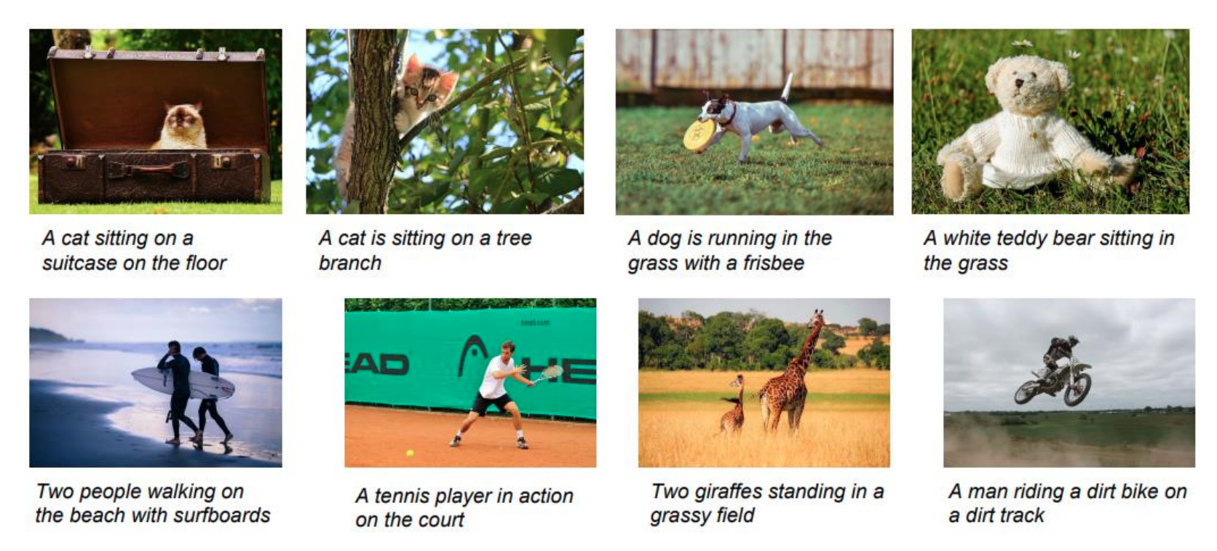
One-to-Many
It deals with fixed size of information as input that gives sequence of data as output.
Ex: Image Captioning → sequence of words.

Slide 23
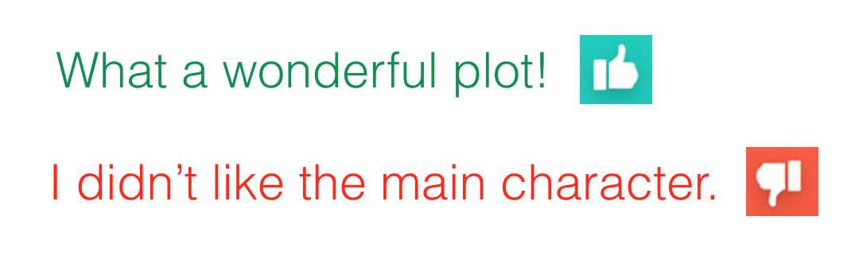
Many to One
It takes Sequence of information as input and ouputs a fixed size of output.
Ex: Sentiment analysis where a given sentence is classified as expressing positive or negative sentiment.

Slide 24
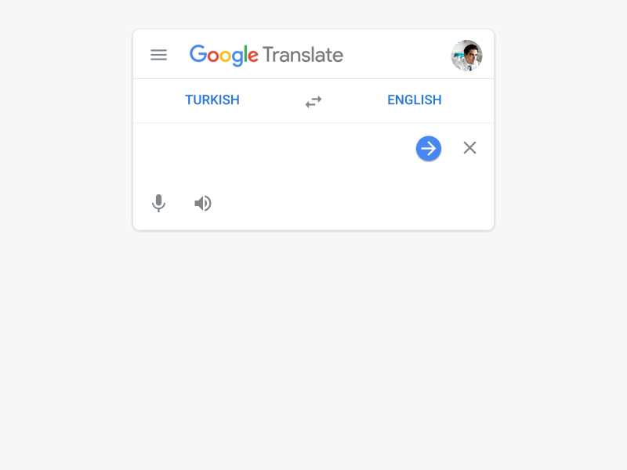
Many to Many
It takes a Sequence of information as input and process it recurrently outputs a Sequence of data.
Ex: Machine Translation.

Slide 25
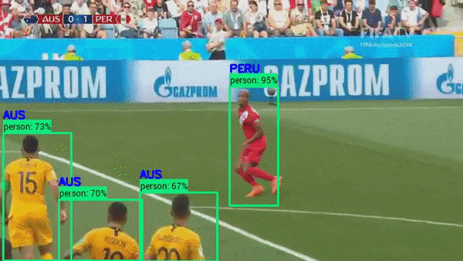
Bidirectional Many to Many
Synced sequence input and output.
Notice that in every case are no pre-specified constraints on the lengths sequences because the recurrent transformation (green) is fixed and can be applied as many times as we like.
Ex: video classification where we wish to label each frame of the video.

Slide 26
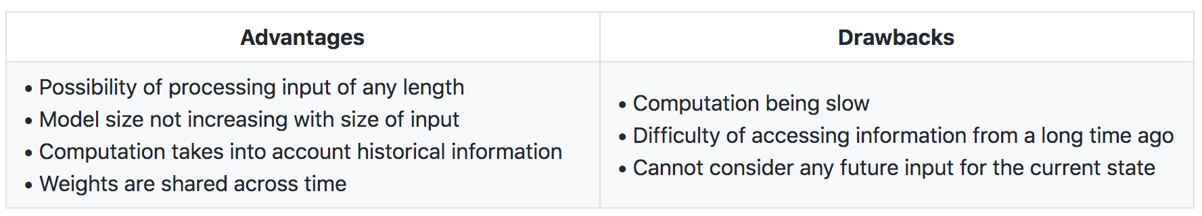
The Pros and Cons of A Typical RNN Architecture

Slide 27
Problem with RNN
Vanishing gradient problem.
Exploding gradient problem.
Long-Term dependencies problem.
During backpropagation

Slide 28
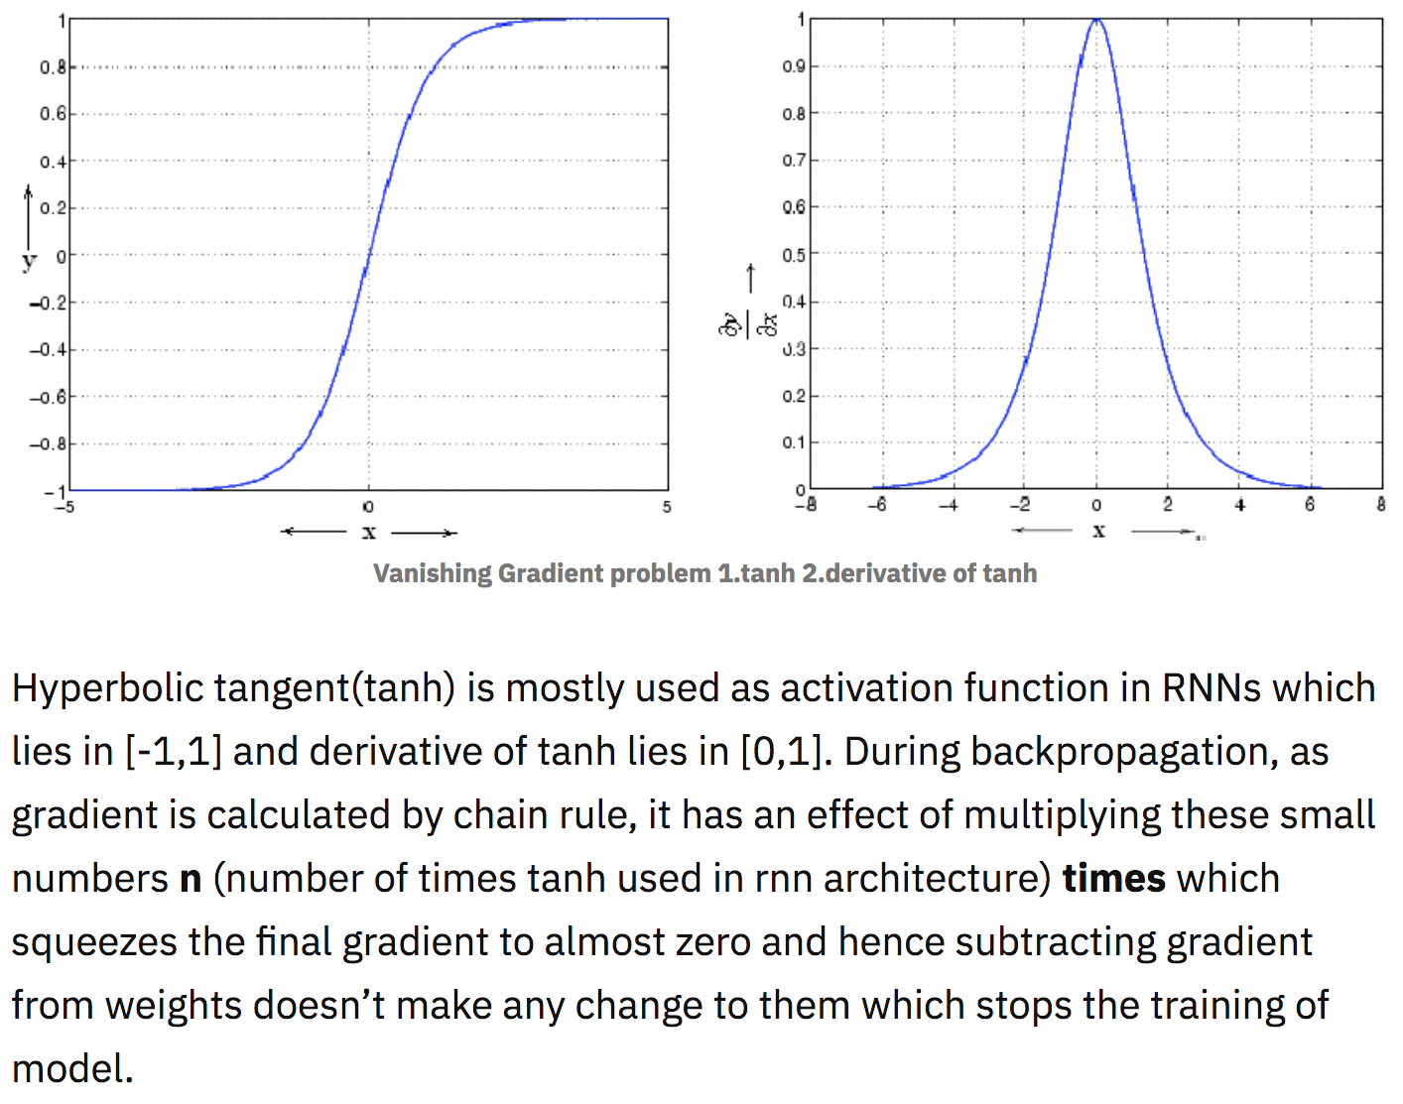
Vanishing Gradient Problem

Slide 29
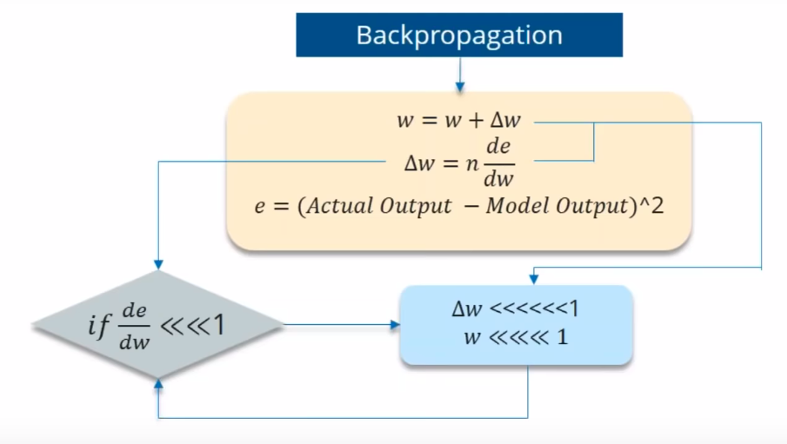
Vanishing Gradient Problem
If the partial derivation of Error is less than 1, then when it get multiplied with the Learning rate which is also very less.
Then Multiplying learning rate with partial derivation of Error wont be a big change when compared with previous iteration.
Lets say the value decreased like 0.863 →0.532 →0.356 →0.192 →0.117 →0.086 →0.023 →0.019.
We can see that there is no much change in last 3 iterations.

Slide 30
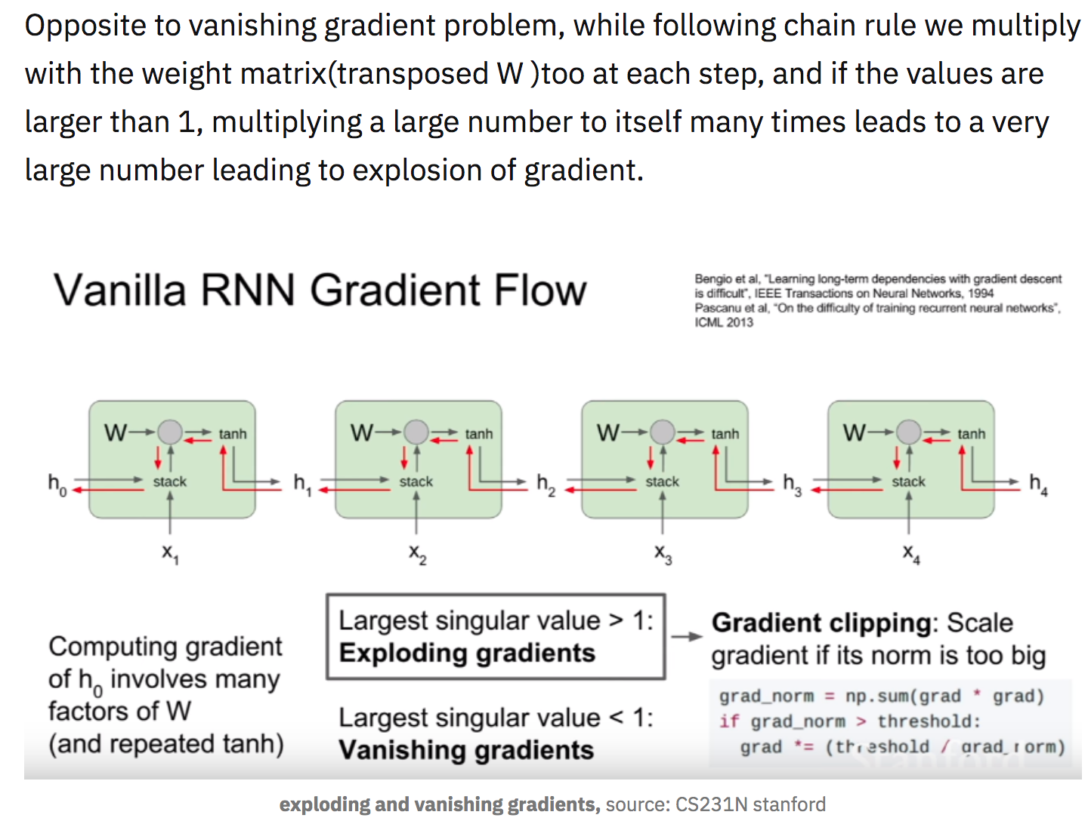
Exploding Gradient Problem

Slide 31
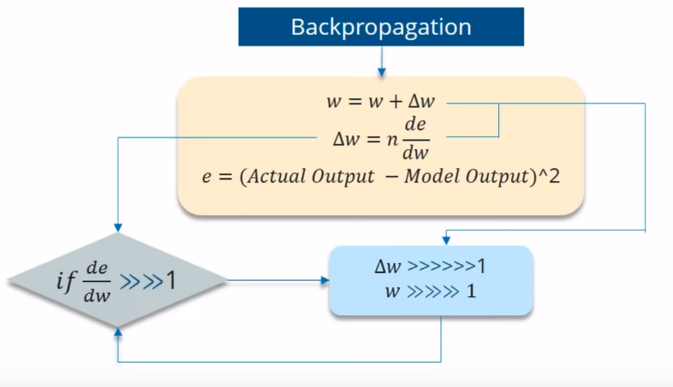
Exploding Gradient Problem
What if the Partial derivation of Error is more than 1?

Slide 32
Solutions for Vanishing & Exploding Gradient
Vanishing Gradient
Relu activation function.
LSTM, GRU.
Exploding Gradient
Stop backpropagating after a certain point, which is usually not optimal because not all of the weights get updated.
Penalize or artificially reduce gradient.
Put a maximum limit on a gradient.
RMSprop to adjust learning rate.

Slide 33
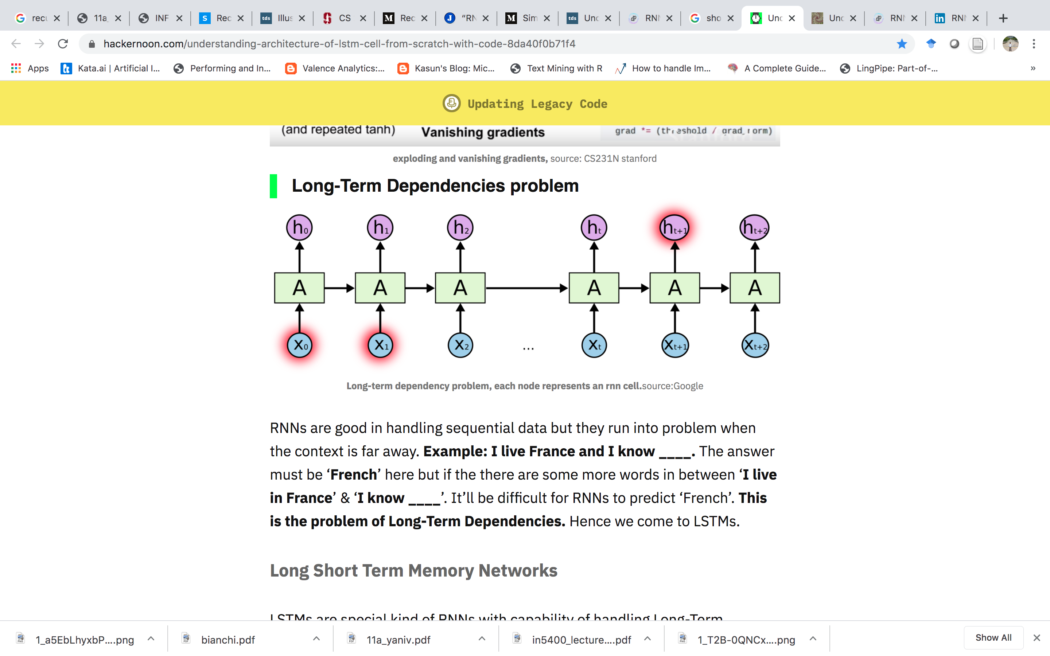
Long-Term Dependencies Problem

Slide 34
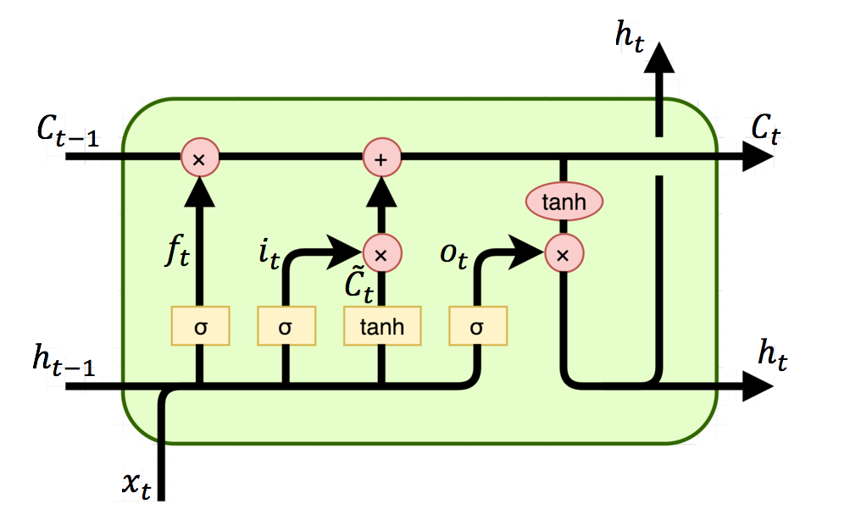
LSTM (Long-Short Term Memory)

Slide 35
LSTM
LSTM’s have a nature of remembering information for a long periods of time.
The core concept of LSTM’s are the cell state, and it’s various gates.

Slide 36
LSTM Cell State
The cell state carries relevant information throughout the processing of the sequence.
As the cell state goes on its journey, information get’s added or removed to the cell state via gates.

Slide 37
LSTM Gates
The gates are different neural networks that decide which information is allowed on the cell state.
The gates can learn what information is relevant to keep or forget during training.

Slide 38
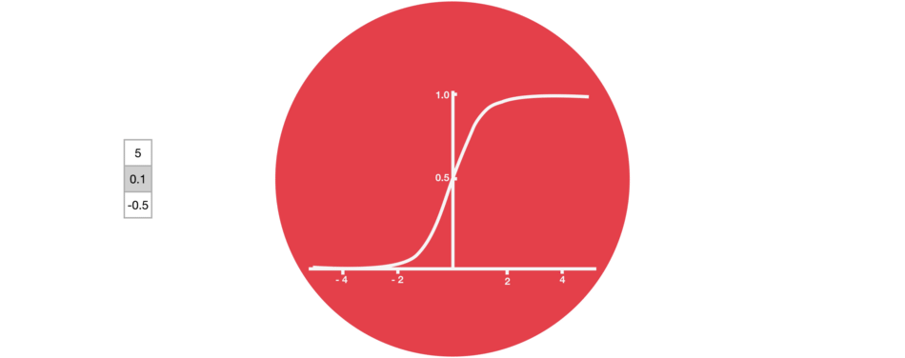
Sigmoid
Gates contains sigmoid activations.
A sigmoid activation is similar to the tanh activation.
It squishes values between 0 and 1.

Slide 39
Sigmoid
The network can learn which data is not important therefore can be forgotten or which data is important to keep.
That is helpful to update or forget data because any number getting multiplied by 0 is 0, causing values to disappears or be “forgotten.”
Any number multiplied by 1 is the same value therefore that value stay’s the same or is “kept.”

Slide 40
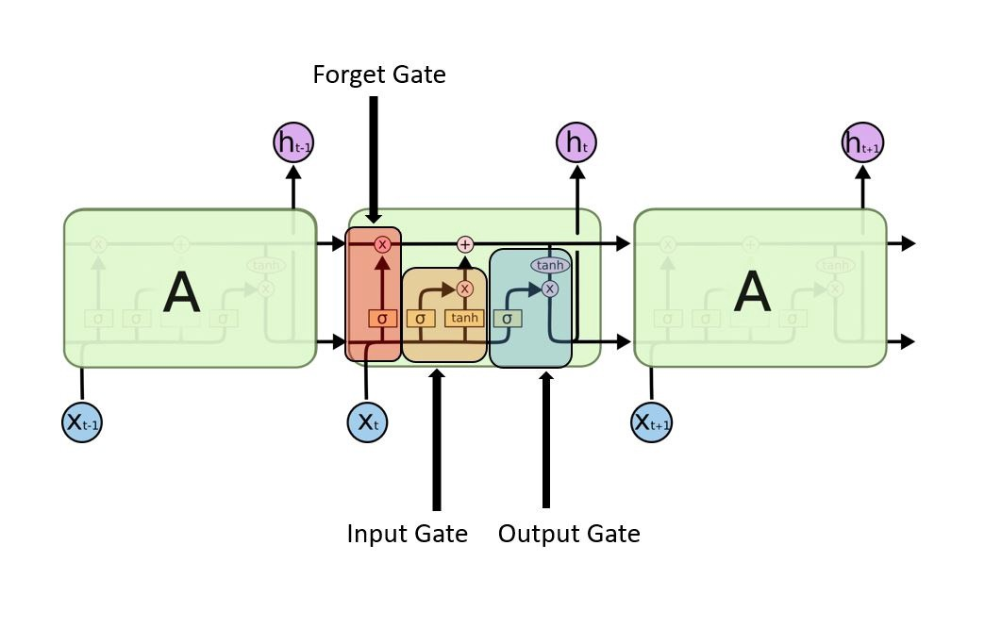
LSTM Step Process
Every LSTM has 3 gates:
Forget gate
Input gate
Output gate

Slide 41
Forget Gate
Decides how much of the past you should remember.
After getting the output of previous state, h_{(t-1)}, Forget gate helps us to take decisions about what must be removed from h_{(t-1)} state and thus keeping only relevant stuff.
It is surrounded by a sigmoid function which helps to crush the input between [0,1].
The closer to 0 means to forget, and the closer to 1 means to keep.

Slide 42
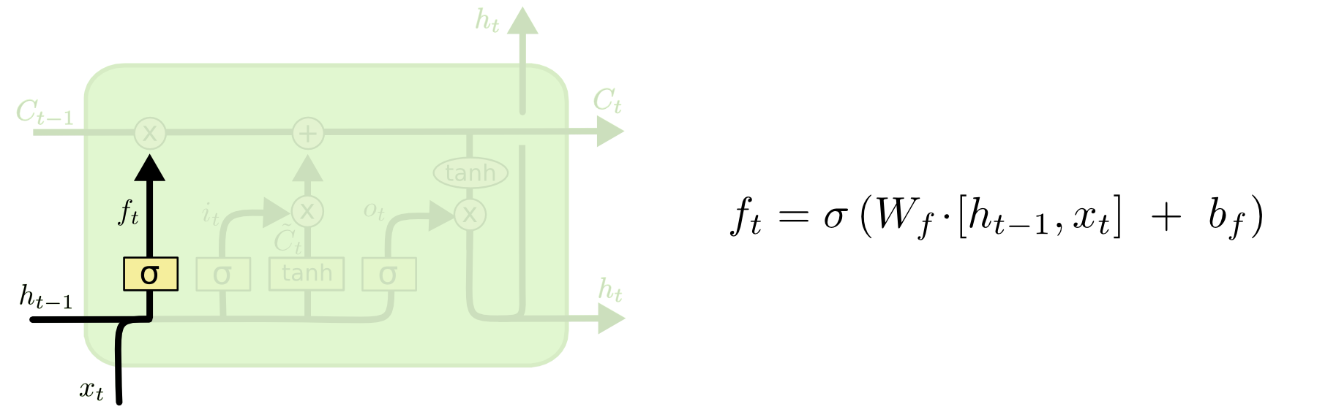
Forget Gate

Slide 43
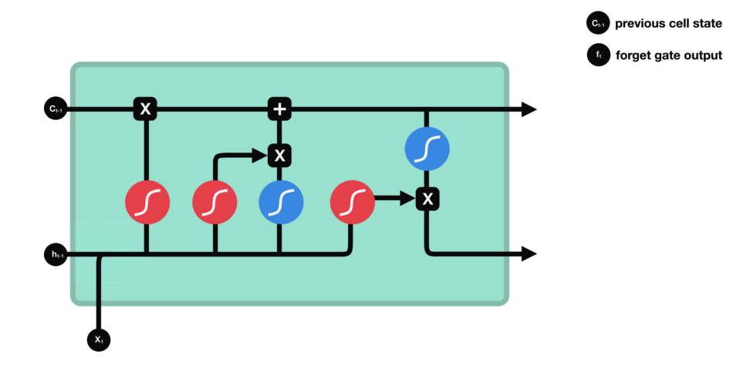
Forget Gate Operations

Slide 44
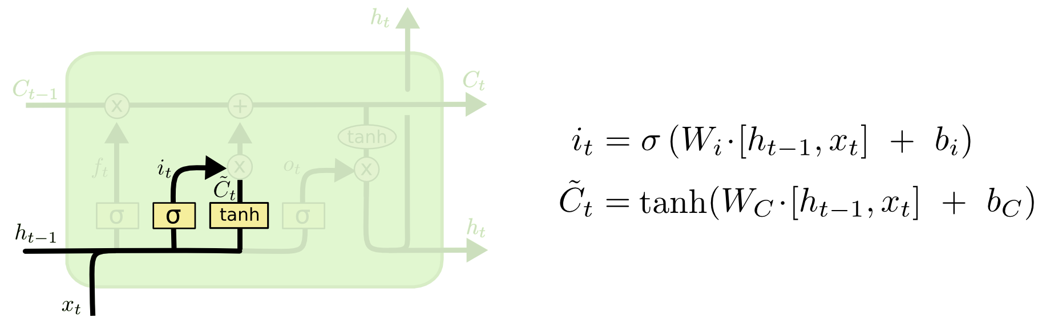
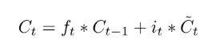
Update Gate/Input Gate
Decides how much of this unit is added to the current state.
Sigmoid layer decides which values to be updated and tanh layer creates a vector for new candidates to added to present cell state.
To calculate the present cell state, we add the output of ( (input_gate*gate_gate) and forget gate) as shown below.

Slide 45
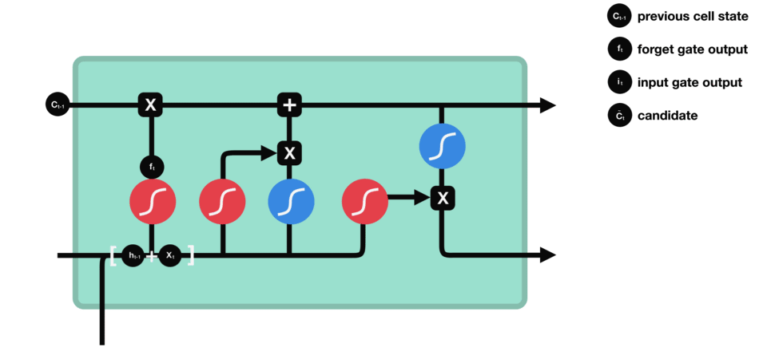
Update/Input Gate Operations

Slide 46
Cell State
The cell state gets pointwise multiplied by the forget vector.
This has a possibility of dropping values in the cell state if it gets multiplied by values near 0.
Then we take the output from the input gate and do a pointwise addition which updates the cell state to new values that the neural network finds relevant.
That gives us our new cell state.

Slide 47
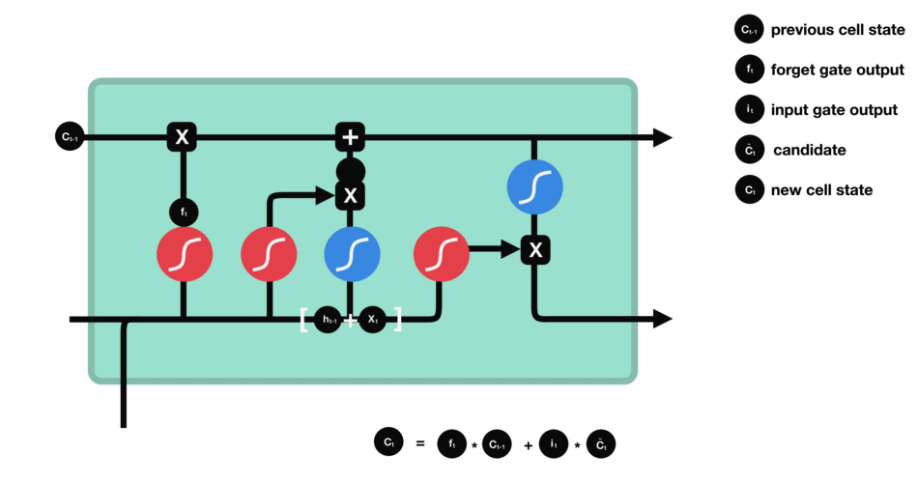
Cell State Calculation

Slide 48
Output Gate
The output gate decides what the next hidden state should be.
Remember that the hidden state contains information on previous inputs.
The hidden state is also used for predictions.

Slide 49
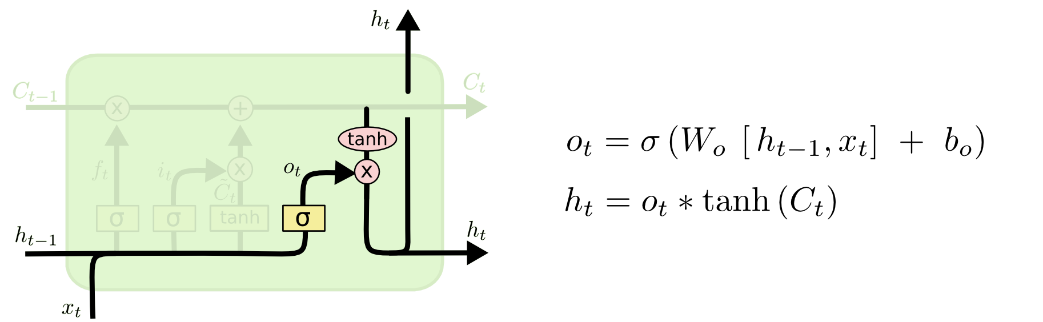
Output Gate
Decides which part of the current cell makes it to the output.
We decide what to output from our cell state which will be done by our sigmoid function.
We multiply the input with tanh to crush the values between (-1,1) and then multiply it with the output of sigmoid function so that we only output what we want to.

Slide 50

Output Gate Operations

Slide 51
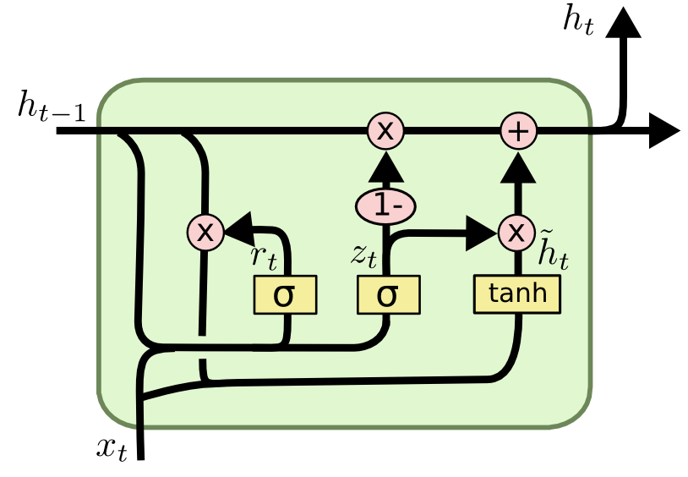
GRU

Slide 52
GRU (Gated Recurrent Unit)
GRU (Gated Recurrent Unit) aims to solve the vanishing gradient problem which comes with a standard recurrent neural network.
GRU can also be considered as a variation on the LSTM because both are designed similarly and, in some cases, produce equally excellent results.
GRU uses the so called, update gate and reset gate.

Slide 53
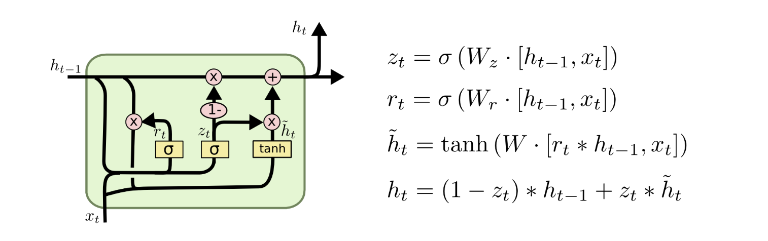
GRU Architecture

Slide 54
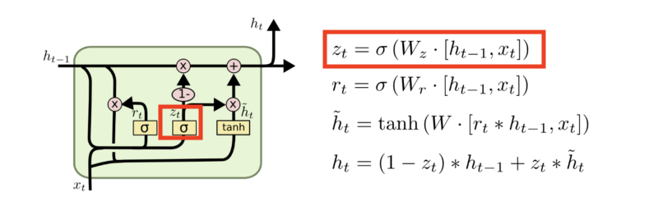
Update Gate

Slide 55
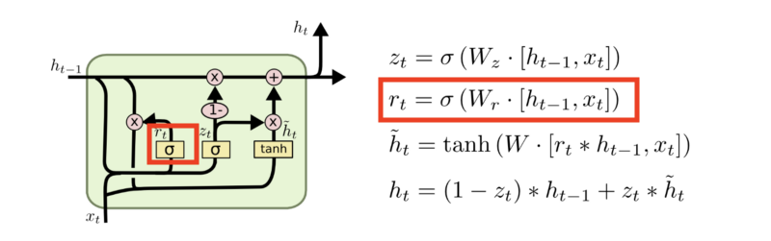
Reset Gate

Slide 56
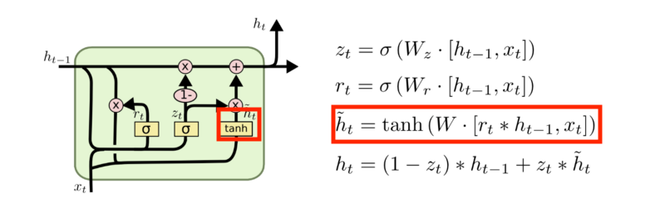
Current Memory Content

Slide 57
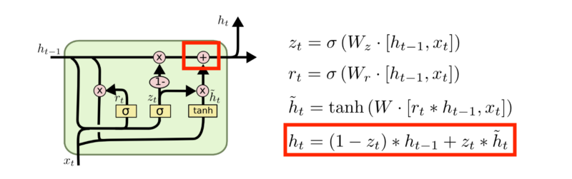
Final Memory at Current Time Step

Slide 58
References
https://colah.github.io/posts/2015-08-Understanding-LSTMs/
https://towardsdatascience.com/animated-rnn-lstm-and-gru-ef124d06cf45
https://towardsdatascience.com/illustrated-guide-to-lstms-and-gru-s-a-step-by-step-explanation-44e9eb85bf21
https://hackernoon.com/understanding-architecture-of-lstm-cell-from-scratch-with-code-8da40f0b71f4

Slide 59


